Slide 1
PurePlay
We design chips, boards, firmware and connected devices.
Capabilities, October 2026
www.pureplay.io
Confidential. Please don't pass this on without checking with us first.

Slide 2




Who we are
We're an engineering team in Hyderabad that turns ideas into working silicon, boards, firmware and connected products. Most of our customers are in automotive, manufacturing and telecom.
Silicon
Hardware
chip design and validation
boards and circuits
32
20+
100+
projects delivered since 2018
clients, from chip makers to global brands
engineers in Hyderabad and Bengaluru
Embedded
IoT
firmware and system software
connected products, end to end

Slide 3



We've built and sold companies like this before
Our founders have built and exited four semiconductor and IoT companies. We know how to grow an engineering team, win global customers and get acquired.
Sicon Tech
InSemi
SilabTech
MiQasa
SEMICONDUCTOR
SEMICONDUCTOR DESIGN SERVICES
HIGH-SPEED SERDES IP
SMART HOME HARDWARE
Started by our founders and taken to a successful exit.
Chip design and embedded software for global semiconductor firms. 900+ specialists.
Low-power, multi-gigabit interface IP used in AI, cloud and networking chips.
Retrofit smart switchboards, lighting and controls, designed and built in Hyderabad.
Exited
Acquired by Infosys, Jan 2024, about ₹280 Cr
Acquired by Synopsys, Mar 2018
60% stake taken by Smartron, Dec 2017
Shyam Bhethanabotla · Founder
Srikar Reddy · Co-founder
Santosh Patil · Founder
Co-founder of CoSci. Leads business development and operations.
Built and exited InSemi, SilabTech, MiQasa and Sicon Tech.
Built and exited MiQasa, the smart home startup.

Slide 4
Silicon: how a chip project runs
From architecture to first silicon. Most clients hand us one or two stages, and some hand us the whole thing.
1
2
3
4
5
6
Architecture
RTL
Verification
Synthesis and P&R
DFT and BIST
Validation
ASIC, SoC, FPGA, mixed-signal, RF
VHDL and Verilog, low power
Simulation, coverage, debug
Timing and power closure
Built-in test structures
Bring-up of new silicon
Hand us a single stage or the whole flow. The same team carries it from first block diagram to working silicon.

Slide 5


Silicon: what chip teams are asking for now
There aren't enough design engineers to go round, so more of the specialised work is being outsourced.
Chiplets and advanced packaging
RISC-V and custom AI silicon
Splitting one big chip into several dies means someone has to make them talk. We work on UCIe-style die-to-die links, 2.5D and 3D package and interposer design, and the thermal checks that go with them.
Teams want their own cores and accelerators without a licence bill. We integrate RISC-V with custom extensions and build low-power SoCs for vision, sensing and automotive.
Verification, done faster
High-speed and mixed-signal IP
Verification is where most chip schedules slip. We build UVM and constrained-random environments, add formal checks, prototype on FPGA and use ML to rank tests and close coverage sooner.
SerDes, PHYs and data converters need rare mixed-signal skills, and AI data-centre links keep raising the bar. This is the area our founders know best from SilabTech.
Tailwind: India's Design Linked Incentive scheme (₹1,000 crore) is set to back about 30 chip-design companies in 2026-27.

Slide 6





Silicon: front-end design and verification
Front-end design and verification, across nodes from 3 nm to 40 nm and above.
Design
Protocols
Verification
Languages and tools
Micro-architecture
RTL coding and SoC integration
Linting, CDC, low-power formal
Synthesis and logic equivalence
AMBA AXI, ACE, AHB, APB, CHI
PCIe Gen 1 to 5
DDR2 to DDR5 and LPDDR
USB 3.0, MIPI, SPI, I2C, I3C
Ethernet, SATA, SAS
IP, SoC and processor level
Coverage-driven and assertion-based
Formal and low-power aware
Portable Stimulus (PSS)
UVM, OVM, VMM
VCS, Questa, IES
Spyglass, Conformal, Formality
Verilog, SystemVerilog, C, C++, SystemC
Reference customers from our founders’ InSemi years

Slide 7


Silicon: physical design and signoff
Physical design, from netlist to GDSII.
Synthesis
Place and route
Timing
Chip-level signoff
RTL and physical synthesis
DFT insertion
Low-power aware flows
Formal verification
Floorplanning and partitioning
Clock-tree synthesis
Multi-mode, multi-corner optimisation
UPF and CPF-aware flows
High utilisation
Timing budgeting
Constraints development
External IO interface
ECO generation
Chip-level closure
Hierarchical design, flat STA closure
Physical verification
IR and EM checks
SoC low-power checks
Reference customers from our founders’ InSemi years

Slide 8

Silicon: DFT and post-silicon validation
Making chips testable, and proving the first silicon works.
SoC and IP DFT
Memory test and ATPG
Reliability and debug
Post-silicon validation
Hierarchical and flat scan
OCC insertion and compression
P1500 wrappers
JTAG 1149.1, 1149.6 and IJTAG
MBIST with and without repair
Row and column redundancy
Stuck-at, transition and path-delay patterns
Low-power ATPG
Burn-in, HTOL and HAST
Scan diagnosis
Yield analysis
Structural pattern bring-up
USB, PCIe, Ethernet to 10G
DDR and LPDDR PHY
Python, Perl, LabVIEW, Tcl automation
Scopes, analysers, Trace32 debug
DFT tools we work in: Tessent, DFT MAX, TetraMax, Modus and Fastscan, across Cadence, Siemens EDA and Synopsys flows.

Slide 9

Silicon: mixed-signal and foundation IP
Analog, mixed-signal and foundation IP, including SerDes up to 16 Gbps.
Foundation IP
Analog IP
RF and full chip
IP automation
Standard cell libraries
Memory compilers: HD, HS, RF, cache
IO libraries: GPIO, DDR, LVDS, ESD
FinFET work at 10, 14 and 16 nm
SerDes up to 16 Gbps
PLLs: digital, low-jitter ring and LC
Pipeline and SAR ADCs, current-steering DACs
LDO, bandgap, DC-DC
LNA, PA, VCO and mixer layout
Full-chip physical verification
Flip-chip and wire-bond strategy
EM, IR and signal integrity
GenIP: reusable IP, push-button instances
Skill and Perl scripting
Custom DRC deck coding
Technology migration
Heritage: our founders built SerDes and mixed-signal IP at SilabTech, acquired by Synopsys in 2018.

Slide 10
Hardware: boards, circuits and enclosures
We take a product from a block diagram to something you can manufacture.
Architecture
ASIC, SoC, FPGA, mixed-signal, RF and low power.
26
Circuits
High-speed links, audio, video and imaging, RF, simulation and thermals.
layers on the boards we design
Boards
HDI, impedance control and signal integrity, plus boards for validating new silicon.
0.3 mm
Mechanical
Prototypes, production, thermal analysis and ergonomics.
pitch, routed and signal-checked

Slide 11
Hardware: AI-server and high-speed boards
AI servers pushed signal speeds and power up at the same time. A few things decide whether a board works.
WHAT GOES WRONG
WHAT WE DO
Signals degrade at PCIe 6.0, DDR5 and 112G SerDes speeds.
Plan loss budgets early, route and simulate the channels, and choose low-loss materials.
WHAT GOES WRONG
WHAT WE DO
Simulation and the bench disagree.
Correlate signal and power integrity models against lab measurements.
WHAT GOES WRONG
WHAT WE DO
Accelerators draw huge transient currents and run hot.
Design the power network and the thermal path together with the stack-up.
Next wave: about 47% of AI racks are expected to be liquid-cooled in 2026 (TrendForce), and 224G links and co-packaged optics are close behind.

Slide 12
Embedded: firmware and system software
We work across the stack, from the driver up to the application.
Applications
That means board bring-up, BSPs and OS kernel ports, bootloaders, device drivers, protocol stacks for Ethernet, Wi-Fi and storage, Linux and Android work, FPGA and programmable logic, and testing of new silicon.
Libraries and codecs
OS and kernel
Protocol stacks
Architectures we work on
ARM
MIPS
Tensilica
Device drivers
MCU, MPU and DSP
Power
x86
DSP
Hardware and logicware

Slide 13
Embedded: from concept to certified product
How we take a connected product from idea to production.
1
2
3
4
5
6
Concept and analysis
Design
Prototype and test
Certify
Production
Support
Feasibility, budget, project plan, architecture
Schematics, PCB, FPGA, firmware, BSP, enclosure
Sourcing, assembly, bring-up, system tests
EMI/EMC pre-compliance, FCC, CE, UL
Handover, manufacturing tests, diagnostics
Post-delivery support and product sustenance
Certification is where hardware projects quietly lose months. We plan for it from day one.

Slide 14


Embedded: edge AI, firmware and vehicles
Nobody asks any more whether a model can run on the device. They ask whether it can be shipped and supported for ten years.
Edge and physical AI
A modern firmware workflow
Software-defined vehicles
Inference on microcontrollers with built-in NPUs, model quantising and packaging, and sense-decide-act loops inside a few milliseconds. We also debug devices already in the field.
Zephyr RTOS bring-up and board support, RISC-V firmware including FPGA targets, CMake and CI/CD builds in containers, and hardware-in-the-loop tests so a release never depends on one laptop.
Virtual ECU environments let teams test software, peripherals, interrupts and timing before the hardware exists, as cars move to zonal and central compute.
Why now: TI is putting an NPU across its whole MCU line, and Zephyr was in almost every hall at Embedded World 2026. Edge AI has moved from slides to shipping products.

Slide 15
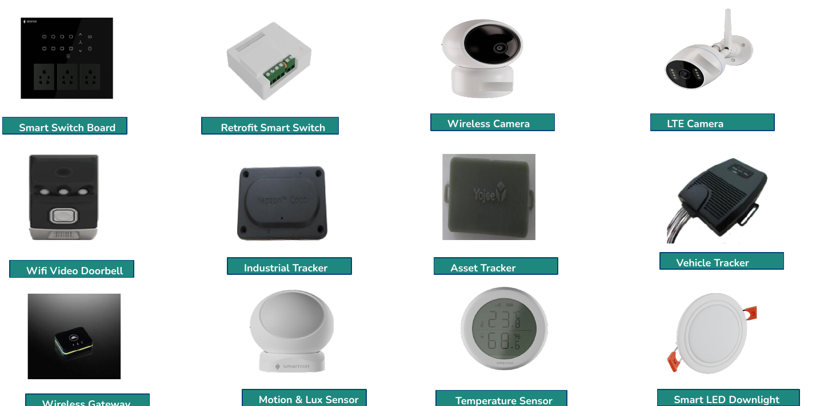
IoT: devices we've taken into production
From smart switches to trackers, these are products that shipped in volume.
Smart home
Switch boards, retrofit switches, bulbs, sensors, doorbells.
Cameras
IP, wireless and LTE.
Industrial
Asset and vehicle trackers, access points, IP backhaul.
We also cover the OS and drivers, the companion app, cloud, production testing and design for manufacturing.
Wearables and auto
Watch, tracker, belt, glove.

Slide 16
IoT: what's changing
Four shifts that decide which connected products win over the next few years.
1
More of the thinking happens on the device
2
Some devices run without batteries
Sensors, cameras and trackers analyse data locally, so less goes to the cloud and responses are quicker.
Energy harvesting plus on-device inference suits places where changing batteries isn't practical.
3
More ways to connect
4
2G and 3G shutdowns force a redesign
Matter over Thread is making smart homes interoperable, 5G RedCap and satellite NB-NTN stretch cellular reach, and Wi-Fi HaLow is forecast to grow from 19M to 124M devices a year by 2030 (ABI Research).
LTE-M and NB-IoT are the default replacements, and their radios differ, so fleets in the field need new hardware.

Slide 17
Services buyers are asking for right now
What we see the most buying activity around in each of our four areas.
Silicon
Hardware
Embedded
IoT
Chiplet and 2.5D/3D package co-design
RISC-V and AI accelerator SoCs
AI-assisted verification and DFT
AI-server boards at PCIe 6.0, DDR5 and 112G+
Power and liquid-cooling-aware design
Board bring-up for new silicon
Edge AI on NPU microcontrollers
Zephyr and RISC-V firmware with CI/CD
Virtual ECUs for software-defined vehicles
Matter and Thread device development
RedCap, LTE-M and satellite-ready modules
Battery-free, ultra-low-power sensors
Based on 2026 industry research: Embedded World, MWC, TrendForce, ABI Research and India Semiconductor Mission.

Slide 18
The market is moving our way
A few numbers behind the demand.
₹1,000 Cr
47%
6.5x
19.5%
India's Design Linked Incentive outlay, backing about 30 chip-design companies in 2026-27.
of AI server racks expected to be liquid-cooled in 2026 (TrendForce).
more Wi-Fi HaLow devices a year by 2030, from 19M to 124M units (ABI Research).
expected yearly growth in automotive zonal-architecture spend through 2032.
One theme runs through all four: more intelligence, more complexity, and not enough engineers to go round.

Slide 19
Who we work with
Semiconductor leaders, engineering companies and global consumer brands.
Semiconductors
Engineering and devices
Enterprise
Intel
Altran
Smartron
Target
Walmart
Sephora
Nike
Walgreens
H&M
Halliburton
Avery Dennison
HERE
Yojee

Slide 20






















Customers our founders have served
At InSemi, our founders' team worked with 65+ marquee customers worldwide, including these.
Chip makers
Also: Intel, Micron, Microsemi
EDA, foundry and industry
Also: ABB, GE, BEL, Suez, Bühler
Fabless innovators
Also: Open-Silicon
Logos are trademarks of their respective owners. Customer list taken from InSemi’s 2022 corporate overview.

Slide 21
Tell us what you're building.
Offices
Hyderabad (headquarters)
Bengaluru
Illinois, USA
We'll tell you honestly whether we're the right team for it.
Contact
Shyam
+91 9959155955
www.pureplay.io

